Slide 1
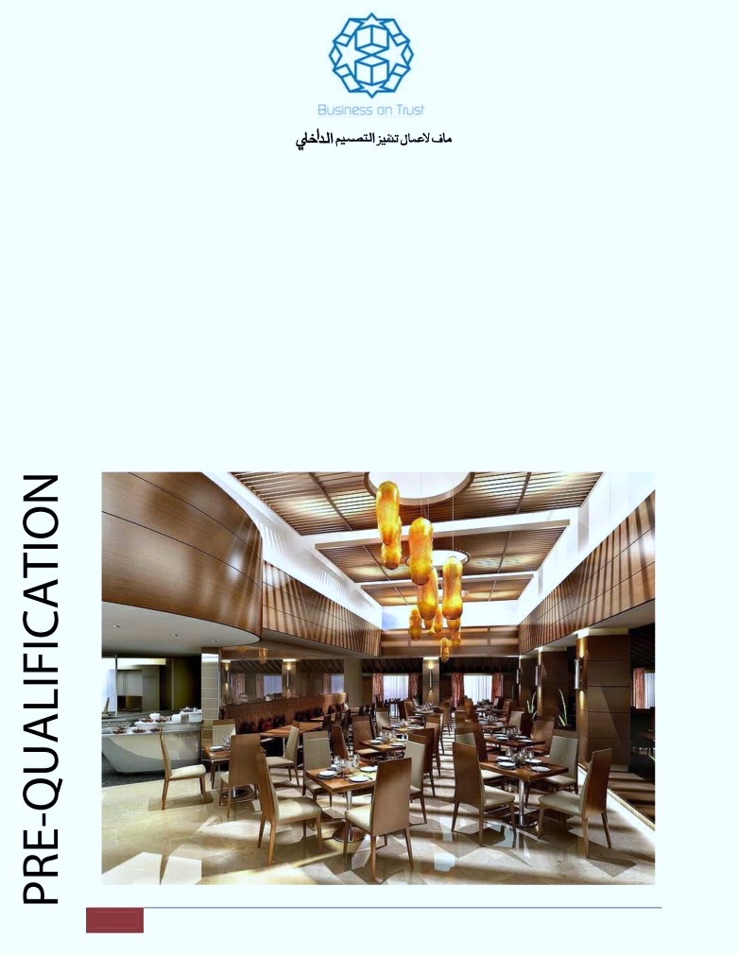
“Turnkey Interiors & Graphics Solutions”
WE TRANSFORM YOUR IMAGINATION INTO REALITY
E-mail: projects@maftrades.com
P.O Box: 121884,Dubai,UAE For Sales & Inquiries
+971 55 4804242
1
One Stop for Complete Interior Solutions.

Slide 2
MAF DESIGN & BUILD
INTERIOR DESIGN & FIT-OUT CONTRACTING DIVN.
_____________________________________________________________________
Last Updated June 2018
Ref No: MAF/PL /201/909
United Arab Emirates
Kind Attn: Mr.
Dear sir,
Sub : Design & Decor Offer
We have pleasure to offer our services for the following:
Space Planning and Design for Office areas :
Our creative designers can offer space planning & functional concept designs for optimum placements to suit your furniture and storage requirements.
Mall showrooms and Restaurants :
We design & build customer friendly environment for Showrooms, Restaurants and Fast Food Outlets, Office Interiors
Premium luxury villas, Residential & Hotel Apartments :
Our design studio can present 3D & AutoCAD views for your living rooms, Majlis,
Dining & Bedrooms - Space planning & functional interior fittings that match to your taste & Elegant ambience, that are appealing to your requirements.
We have in-house facility for manufacturing furniture - Beds, Sofa, Wardrobe, Kitchen Cabinet & Soft-Furnishings.
2
One Stop for Complete Interior Solutions.

Slide 3
Residential, Commercial, Retail and Hospitality Industry:
We undertake turnkey projects for Design and Build of Star Hotels & Apartment,
Residential Villa’s, Retail Outlets, Office’s All Kind of Restaurants Spa & Gym Etc.
As we have a strong foothold in the region and have in-house infrastructure - for Design, Joinery
works, well-organized logistics and experienced Artisans, Carpenters, Site Engineers and Professional Managers to handle the turnkey projects to the Customers’ entire satisfaction. Addl. Services offered are:
ALLUMINIUM
FINISHING
SPECIAL WORKS
UTILITIES
BUILDING
Carpeting
Bathroom tting
Air conditioning
Carpentry
&
All kind of Flooring
Fitted furniture
Alarms & Security
Specialist Joinery
GLASS WORKS
Decorating
Specialist Joinery
Electrical
Gypsum Ceilings
Decorative painting
Kitchen tting
Home networking
Gypsum Partitions
polishing
Protection solutions
Telecoms
Parquet / Wood
Lacquering
Stone masonry
Plumbing
ooring
Stone tiling
Wood ooring
Roo ng
Landscaping
Wall Covering
Metal works
Structural works
Designs
Windows
Pergolas
SOFT - WORKS
Automatic gates
Gazebo
Curtain tting
Steel Structures
Curtain making
Construction
Upholstery
Service
Visitor Sofa
Swimming Pools
Lounge Sofa
Foundations
Refurbishment of
Ground works
Fabrics etc on
Bricklaying
furniture.
Plastering
All services are provided directly by
MAF Technical Services
LLC.
INTERIOR DESIGN & DECOR DIVN.
or through their network of abilities
We Kindly Request you to provide us a chance to work and Prove our Ability .
Thanks and Regards,
For MAF Interior & BUILD
3
One Stop for Complete Interior Solutions.

Slide 4
PROJECTS AND CLIENTS (DESIGN & EXECUTION):
COMMERICAL AND RESIDENTIAL.
1.
Projects execution for designs of Juma Al Majid, Fu r. Dvn.
2.
SPECTRUM INDUSTRIES, Dubai Inv. Park.
3.
BARJEEL GEOJIT SECURITIES - All Branches.
4.
MAC AL GURG, Dubai.
5.
Projects execution for designs of JC McLean.
6.
PINO MERONI, Mall of the Emirates.
7.
AL SAFI COMMERCIAL BROKERS, Dubai.
8.
INDEPENDENT BUREAU OF INSPECTION & TESTING, SHJ.
9.
MINERVA LAB, Dubai.
10. METCOSTAR TRANSPORT, Dubai Inv. Park
11. SHIP INTERIORS - DARIYA PARK, Shaheen And Samurai Vll (in Ajman port & hamariya port).
13. GULF FINANCE, Sh. Zayed Rd, Dubai.
14. AL ZAHEER REAL ESTATE, Dubai.
15. G + 6 Gold Building at DMCC. (Ceiling Work)
16. G + 18 Fortune Tower Dubai. (Ceiling & Floor Work )
17. Inter Roller Middle East LLC. Dubai.(Turnkey)
4
One Stop for Complete Interior Solutions.

Slide 5
17.
2B + G + 8 Floor Hotel Apartment in Deira (Ceiling Work )
18.
4B + G + 14 Typical Floor Hotel Appts. Dubai Marina
Corridor Ceiling.
19. G + 22 Typical Floor Resi. Building Marina 101
20.
G + 4 School Building Al-Warqa.
21.
G + 12 Residential Building Al-Nahda ( Bin Belella Cont. )
22.
German Visa Application Center (Abu-Dhabi)
23.
VFS Global Co-operative o ce (DIC-BTC)
24.
G + 18 Commercial Building Business Bay (Tav Cont.) ETC.
PROJECTS AND CLIENTS (DESIGN & EXECUTION):
COMMERICAL AND RETAIL.
1.
Sami Barakat Jewelers Dubai Mall Gold Souk.
2.
Kiani Jewelers Dubai Mall Gold Souk.
3.
Dubai Creek Jewelers Dubai Mall Gold Souk.
4.
Maitha Jewelers Dubai Mall Gold Souk.
5.
Labelle Jewelers Dubai Mall Gold Souk.
6.
Soraya Jewelers Dubai Mall Gold Souk.
7.
S. Diamonds Jewelers Dubai Mall Gold Souk.
8.
Metro Group of Electronics Al- Ras Dubai.
9.
ETA Star Metro O ce and Meeting Rooms Dubai.
10.
ETA Star Metro Basement Prayer Room for Sta .
11.
Sheik Majid Al Qasmi Co-operative o ce Sharjha.
12.
Barakat Jewellers Dubai Mall Gold Souk.
13.
G.B. Jewelers Mina AL Salam Hotel Dubai.
14.
Lafayat Fashion Avenue Dubai Mall and Many more.
15.
G.B. Jewels (Souk Madinat Al- Jumeirah)
16.
Awad Al Qubaisi Perfume Etihad Mall.
5
One Stop for Complete Interior Solutions.

Slide 6
17.
California Pizza Kitchen (Mall of The Emirates)
18.
Candy Bouquet (Etihad Mall)
19.
9 Nos o ces’ in Jumeirah Lakes Towers
-KEY PROJECTS - OFFICES & SHOWROOMS & Restaurant’s
We have a team of Architects, Designers, Site-Supervisors, Foremen, Electricians, Carpenters, Masons, Plumbers And Painters.
Thus we are able to undertake, supervise, and execute turn-key
projects from dry-wall & demountable gypsum partitions, ceilings, electrical circuitry, and lightings, to custom made workstations, executive o ce suites and automated doors.
6
One Stop for Complete Interior Solutions.

Slide 7
OUR PRIMARY AREAS OF OPERATIONS ARE:
OUR OWNED MANUFACTURING FACILITY FOR
GYPSUM,JOINERY, ALUMINIUM & GLASS WORKS
DOORS
We also specialize in making of Door sets including flush doors and solid wooden doors for Hotels, Towers and Villas in various designs and finishes with Civil Defense Approved Certificate.
7
One Stop for Complete Interior Solutions.

Slide 8
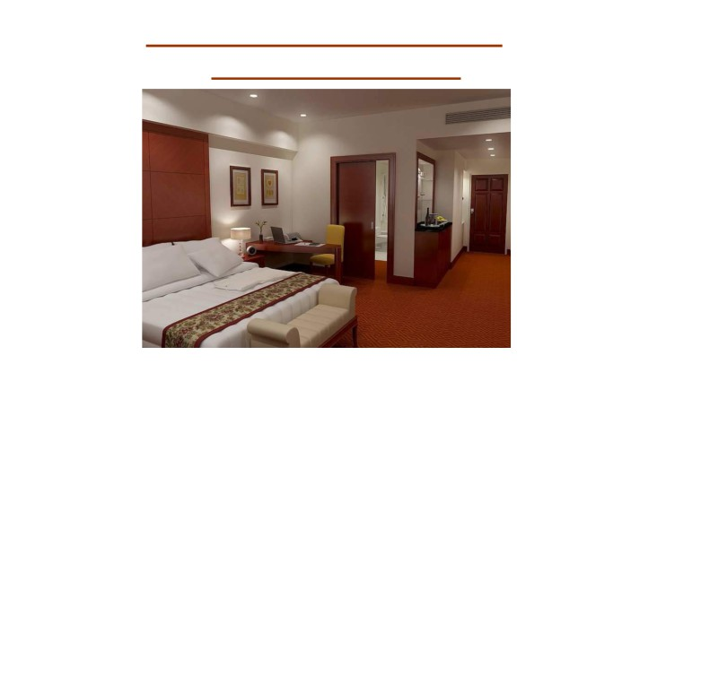
PRODUCTION FACILITY FOR HOTELS & FURNISHED APARTMENTS
Although the local market is flooded with ready-made furniture and furniture manufacturers, we believe that when it comes to bulk orders for hotel furnishings, the preferred option would be to purchase from a ready assemble stock. Other local manufacturers may be able to meet the demands and these are always the option of importing but production or importing is limiting in term of time, and time is money.
With this in mind, we also stock certain fast moving items that cater to the hospitality industry. Double and single beds, bedside tables, dresser unites, luggage racks, mini bar cabinets, wardrobe door, dining tables, breakfast tables and dining chairs. In addition to furniture, our in-house upholstery and soft furnishing service makes it easier for a client to purchase a complete room right down to the duvets and drapes.
8
One Stop for Complete Interior Solutions.

Slide 9
CUSTOM MADE FURNITURE
The customer who expect only the best irrespective of cost and time, our Interior Design Consultants are available to assist with concept design.
Our in-house designers can provide presentations in free-hand sketches and high-end design using 3D & CAD software’s.
Soft furnishing specialist can provide a wide array of fabric.
In addition, should special fabric be required, our suppliers in Europe, USA, Fareast suppliers are able to deliver fabric orders on an urgent basis. Our aim is to cater to the demands of the discerning clients.
9
One Stop for Complete Interior Solutions.

Slide 10
10
One Stop for Complete Interior Solutions.

Slide 11
11
One Stop for Complete Interior Solutions.

Slide 12
12
One Stop for Complete Interior Solutions.

Slide 13
13
One Stop for Complete Interior Solutions.

Slide 14
14
One Stop for Complete Interior Solutions.

Slide 15
STEP 1 Enquiry Registration.
STEP 2 Evaluate for Design Dept/ Procurement/Manufacturing. STEP 3 Prepare relevant Quotation/ Bill of Quantity. STEP 4 Submit o er to client for consideration.
STEP 5 Further meeting with Client to Fine Tune Requirements/Price. STEP 6 Receipt of Order.
STEP 7 Evaluate all Client submissions for accuracy. STEP 8 Check Site.
STEP 9 Begin Drawings or Design Drawings Visuals.
STEP 10 Release Job for Production/ Order outside items. STEP11 Schedule Timeline for Project.
STEP 12 Materials Issue.
STEP 13 Production of Prototype/ Complete Mock Up Samples. STEP 14 Sub Assembly of Products.
STEP 15 Finishing of Products.
STEP 16 Final assembly of all components. STEP 17 Quality Control Inspection. STEP 18 Raise delivery Note and Invoice. STEP 19 Packing and Dispatch of goods. STEP 20 Installation at site.
STEP 21 Client Sign Acceptance.
15
One Stop for Complete Interior Solutions.

Slide 16
We Would like to Thank your For Spending Your Precious Time By Reading Our Prequalification
We are committed to providing you with the highest level of customer satisfaction possible. If for have any query please comment.
we are delighted to hear from you. Call us at +971 4 3175417.
Again, thank you for your patronage. We look forward to serving you In your upcoming Projects.
Thanks & Best Regards
CONTRACTOR
CLIENT / MANAGEMENT
Representing By:
Representing By:
Mr.
AUTHORIZED SIGN.& COM P ANYSTAM P
AUTHORIZED SIGN.& COM P ANYSTAM P
16
One Stop for Complete Interior Solutions.

